Slide 1

simplified
Whitepaper

Slide 2

INTRODUCTION
a community-driven project established in November 2017.
initially founded as an experimental platform to deploy & test smart Contract based games for erc20 tokens.
Project motto:
Decentralize it.
Innovate it.
Community-drive it.

Slide 3
Token details
Name: StakeIt
Symbol: STAKE
Decimals: 8
Type: ERC20 Token
Blockchain: Ethereum
Contract address: 0xbec8f6d667594fb181c9d68e5c80c910888be93d
exchanges: Mercatox (btc), lesfex (btc), etherdelta (eth)
Total Supply: 81,615,116.261787 STAKE (approx. 82 million) 100,000,000 STAKE – destroyed amount (check here)

Slide 4

Token distribution
All unsold tokens will be destroyed
All compound interest reserves are locked in the daily, weekly, and monthly staking smart contracts
Bounty tokens are mostly kept as rewards on smart contract based games (bank roll)

Slide 5
Token distribution
FAQs
How do you ‘destroy’ tokens? Tokens are destroyed by sending it to a popular token burning address here. token destroy address: 0x000000000000000000000000000000000000dead
how will the compound interest reserves be kept? Compound Interest reserves are locked in the staking smart contract. These tokens will not be accessible by anyone.
How does the bounty tokens get used & when will they be used/destroyed? bounty tokens will continuously be distributed until the end of 2018. majority of the tokens will be used as the initial bankroll for smart contract based games (tokens are therefore locked in the contracts)

Slide 6



Main features
Smart contract based games
Decentralized
Automatic payouts
Fair results generated by the smart contract
Simple dice, lottery, wheel of fortune + many more
Requires metamask
Compound interests
Daily, weekly, monthly options
Decentralized (smart contract based)
Automatic deposits & payouts
accurate timer & rewards
Ability to cancel incomplete staking plans
Requires metamask
merchandise store
1000s of cryptocurrency related products
Ability to pay with stake
Affiliates system
revenues used to buy back & fund the staking smart contract

Slide 7

Smart contract based games
Smart contract based games are developed by community developers as opensource projects
Smart contracts can be accessed via the stakeit gitHub page
Stakeit will regularly host dev competitions to develop new games

Slide 8

Smart contract based games
Initial bankroll = bounty tokens (locked-in) smart contract based games earn revenues (stake tokens) whenever users lose their bets The chart on the left illustrates how these revenues will be used/allocated
60% used to fund the staking smart contract
30% locked in the relevant smart contract (to increase max bet amounts for users)
10% used as operational costs (giveaways & game dev competitions)

Slide 9

Compound interests (staking)
Compound interests (staking feature) is based on a smart contract which is decentralized, secure, and automatic.
Users can stake their tokens on a daily, weekly, and monthly basis by depositing their tokens into the smart contract.
The smart contract will hold & AUTOMATICALLY release your “initial amount + staking REWARDS” when you complete your staking plan.
*IF YOU CANCEL ANY ACTIVE STAKING PLANS, YOU WILL IMMEDIATELY RECEIVE the DEPOSITED AMOUNTS BACK TO YOUR ADDRESS*

Slide 10
Compound interests (staking)
Staking rates for ‘daily, weekly, and monthly’ will constantly change,
According to the changing values of stake.
This helps maintain a healthy balance between demand x supply on the market, allowing a CONSISTENT MARKET GROWTH with less volatility.
Daily < weekly < monthly
Monthly rates are higher than weekly and weekly rates are higher than daily to encourage users to hold their tokens LONGER.

Slide 11




Compound interests (staking)
HOW THE staking RATES ARE Determined
Market value of stake is consistently watched by a bot (algorithm)
The bot notifies the core team whenever:
Stake’s market value has increased & it MAINTAINS its value for over xx hours = staking rates
Stake’s market value has decreased & it MAINTAINS its decreased valued for over xx hours = staking rates
The number of hours change constantly, according to the current overall cryptocurrency market status (volume & Stochastic rsi).

Slide 12

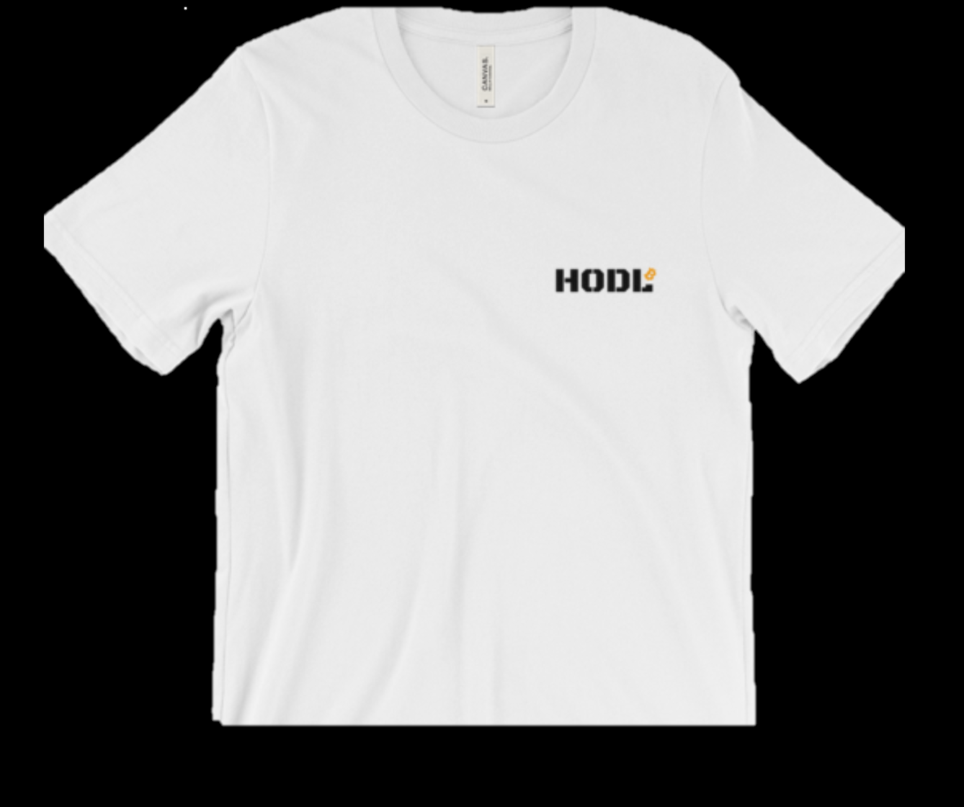

Merchandise store
Cryptocurrency related products ranging from t-shirts to hats, accessories, and posters are sold on the merchandise store Customers are provided with significant discounts when using stake STAKEIT WILL ALSO FORM STRATEGIC PARTNERSHIPS WITH EXISTING POPULAR ONLINE STORES
MERCHANDISE STORE PRODUCT EXAMPLES:

Slide 13

Merchandise store
AFFILIATES SYSTEM
$0.5 for every sign-up referred
10% commissions on all direct sales referred
Earn commissions from your referral’s referrals
All payouts made IN ETh
MORE INFO: www.stake-it.com -> login -> my account -> profile -> my affiliate dashboard

Slide 14

Merchandise store
40% used to buy back & fund the staking Smart contract
40% distributed to the core team members
10% used to fund bounty & giveaways
10% donated to community chosen organizations

Slide 15
roadmap
Q4 2017
Q1 2018
Q2 2018
Token sale
Concept platform beta testing
Exchanges listing
First game development & testing (dice)
WordPress Payment Plugin Integration
Dice game launch
Decentralized staking feature test
Website android app launch
Merchandise store test
Affiliates system launch
Lottery game launch
Wheel of Fortune game launch
Merchandise store launch
Website iOS app
Decentralized staking feature launch

Slide 16
roadmap
Q3 2018
Q4 2018
2019
Additional Exchanges
STAKE GAME DEVs Competition
Advertisement Platform Launch
Voucher System Beta Testing
Desktop & Mobile Wallet Development
Voucher System Launch
4th & 5th Game Launch
STAKE GAME DEVs Competition 2
Partnerships with Popular WordPress Based Shops (STAKE as a form of payment: SAAP)
SAAP Partnership Expansion (Shopify, Magento Store Payment Plugin)
STAKE Debit Cards
Desktop & Mobile Wallet Launch
Mobile Game Launch

Slide 17
FAQs
WHAT WALLETS CAN I USE TO STORE, SEND, AND RECEIVE STAKE? YOU CAN USE ANY ERC20 TOKEN COMPATIBLE ETHEREUM WALLETS. WE RECOMMEND USING METAMASK AS THIS WALLET IS ESSENTIAL FOR STAKE GAMES & STAKING.
What is the ad platform? The AD Platform is where all StakeIt (STAKE) bounty and giveaway campaigns are held. Check the page regularly to participate in various events. Additionally, it also features advertisement spaces which can be bought with StakeIt Tokens (STAKE). It will feature 100 advertisement spaces in total. Once the 100 spaces are filled, the oldest advertisement banner will be replaced with new ones. This cycle will continue endlessly. *Tokens received through ad space sales will be destroyed as part of our token destroy plans*

Slide 18
FAQs
How can I view my stake balance on metamask or myetherwallet?
metamask
Login to your wallet on your browser
Click ‘Tokens’ -> Click ‘Add Token’
Fill in the details as shown on the right & click ‘add’
Myetherwallet
Login to your wallet
Under ‘Token Balances’ on the right side, click ‘Add Custom Token’ & fill in the details as shown on the right
Click ‘Add’
You will be able to see your STAKE balance
Token Contract Address: 0xbec8f6d667594fb181c9d68e5c80c910888be93d
Token Symbol:
STAKE
Decimals:
8

Slide 19
FAQs
Is stake a ponzi scheme / lending platform / hyip? No. stake is driven by smart contracts which are secure, automatic, and decentralized. The only rewards users are provided with are stake tokens. profits are not created out of the ‘thin air’. Staking rewards are readily secured and locked in the staking smart contract. 80% of the bounty tokens are locked in gaming smart contracts as the initial bankroll. No tokens were allocated for the core team (developers) in the token distribution process. Operational costs are covered by the 10% revenues we earn through the gaming smart contracts & the core team (developers) earn – 40% of revenues – generated from the merchandise store.

Slide 20
FAQs
How does the affiliates system work? You are automatically registered as an affiliate as you register on www.stake-it.com.
You can access your affiliate dashboard via My Account -> Affiliate Dashboard.
Receive 10% lifetime commissions on all sales referred by you as well as $0.5 per every sign-up referred. You can purchase affiliate coupons to better track your sales as well as provide incentives (discounts) to your potential referrals.
Ranks & Withdrawal Threshold Basic Marketer – Default Rank – Withdrawal Threshold $30
Good Marketer – From Earnings Over $30 – Withdrawal Threshold $20
Pro Marketer – From Earnings Over $100 – Withdrawal Threshold $10
Multi-level Marketing (MLM) system (Earn commissions up to 4 levels deep)
1st level: Your direct referral (10%)
2nd level: Your direct referrals’ referral (5%)
3rd level: ” (2%)
4th level: ” (1%)

Slide 21




QUESTIONS?
Join the discussions on
FOLLOW US ON

